Slide 1
Advanced E-Commerce “InnovEx Mart”
Name : Lorens Mishra Batch : 2023-2025 Course : Master of Computer Applications Project Guide : Dr. Sarika Yadav

Slide 2
Table of Contents
Introduction
Problem Definition
Motivation
Objectives
Goals
Requirement Specifications
Data Flow Diagram
Flow Chart
Algorithms
Development and Testing
Project Screenshot’s
Benefits and Conclusion

Slide 3
Introduction
Introducing Innovex Mart, a platform designed to streamline the buying, selling, and exchange of electronic products.
To simplify transactions for electronics like laptops, PCs, monitors, and gadgets.
AI-driven personalization for tailored shopping experiences.
User-friendly interface for buyers and sellers.

Slide 4
Problem Definition
Slow website performance and poor load times.
Limited product discovery options.
Inventory and order management inefficiencies.
Security risks with payments and data breaches.

Slide 5
Motivation
Why Innovex Mart?
Address modern consumer demands for efficient and personalized services.
Promote eco-friendliness through trade-ins and reduced e-waste.
Offer secure and user-friendly solutions for buyers and sellers.

Slide 6
Objectives
The objective is to create an advanced e-commerce platform that streamlines electronic product sales, enables trade-ins, promotes sustainability and enhances user and seller experiences.

Slide 7
Goals
Expand product range with sustainable and eco-friendly options.
Introduce advanced AI-powered customer support systems.
Implement a seamless omnichannel shopping experience.
Open additional physical stores in key locations.
Enhance supply chain efficiency using IoT and blockchain technology

Slide 8
Requirement Specifications
User registration and profile management.
Strong security measures.
Strong Admin Dashboard Management.
Chat boat.

Slide 9
Data Flow Diagram
Online Product Shoping
Request for Login Request for registration
USER
ADMIN
Response Response
0 level : DFD (Data Flow Diagram)

Slide 10
login
Admin MST
user MST
Item MST
user MST
Item MST
user
Registration
Search item
account
Buy item
1 level user: DFD (Data Flow Diagram)

Slide 11
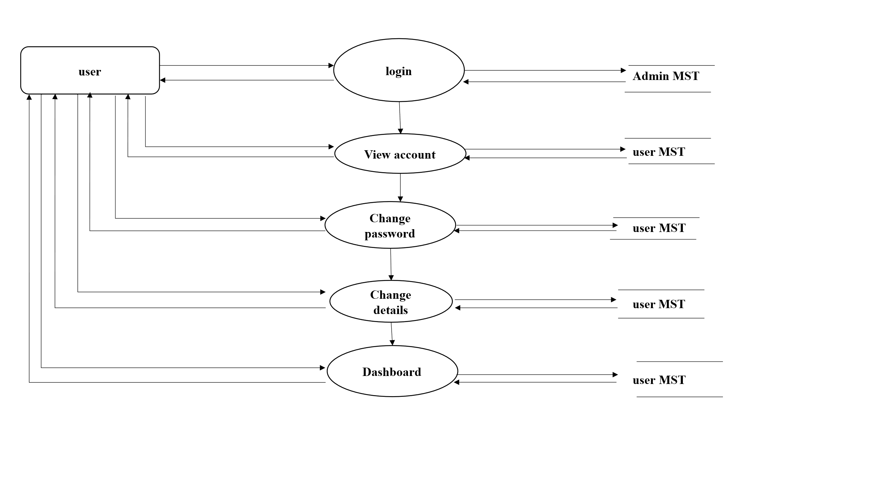
2 level user : DFD (Data Flow Diagram)

Slide 12
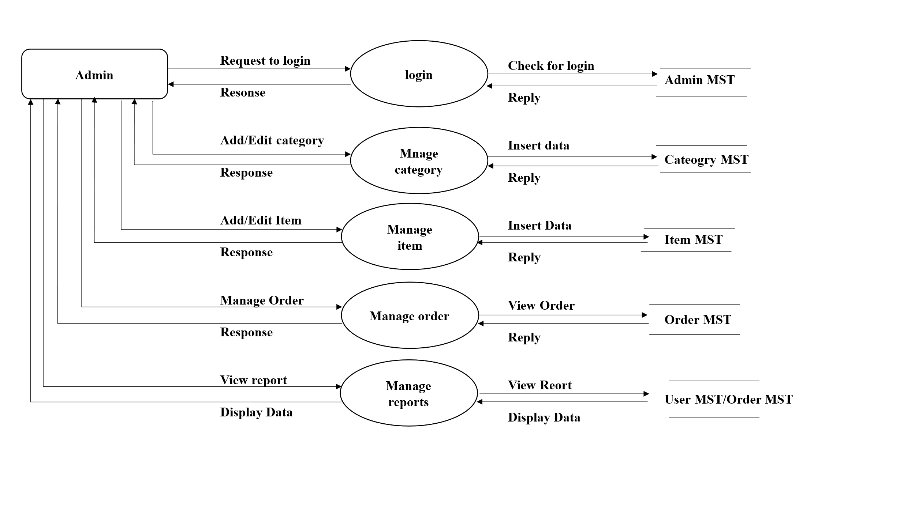
1 level admin : DFD (Data Flow Diagram)

Slide 13
Request to login
Resonse
Check for detail
Reply
Request for view
Reply
Request
Reply
Dispatch order
Reply
login
Admin MST
Order MST
Order MST
Order MST
Admin
View order
Confirm/
cancel order
Dispatch order
2 level admin: DFD (Data Flow Diagram)

Slide 14


Algorithms Used
Bcrypt (Password Hashing)
QuickSort (Product Listing)

Slide 15
Development and Testing
Development Phase:
Frontend Development
Database Design
Testing Phase:
Performance Testing

Slide 16
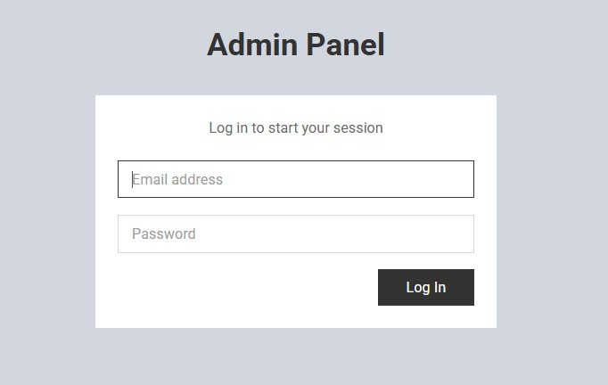
Project Screenshot’s

Slide 17
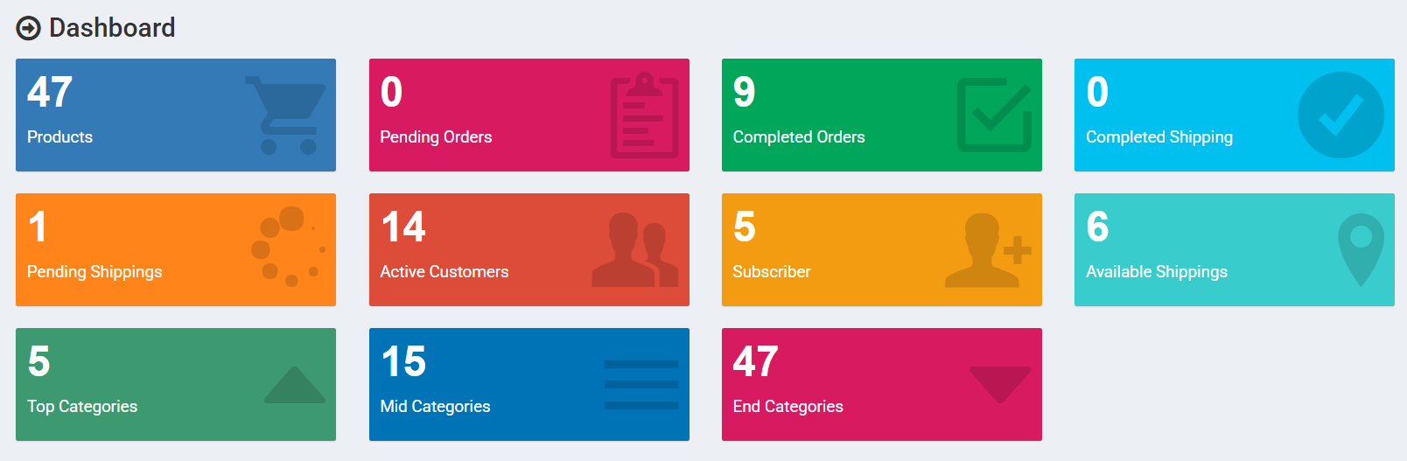
Dashboard

Slide 18
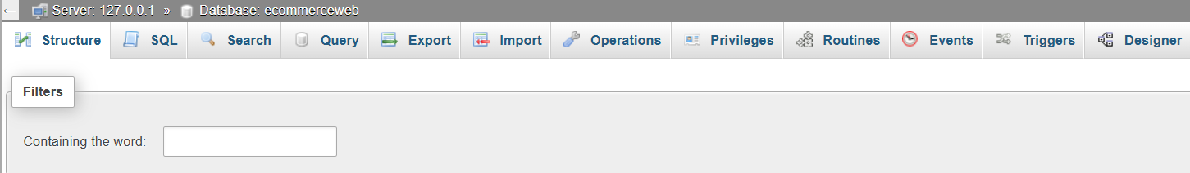
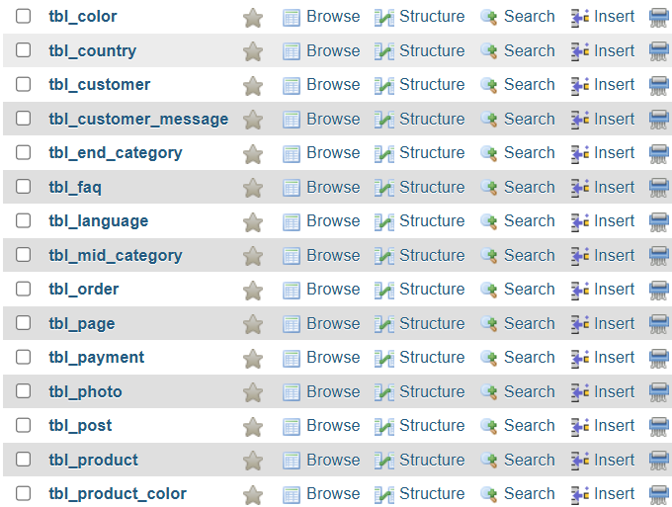
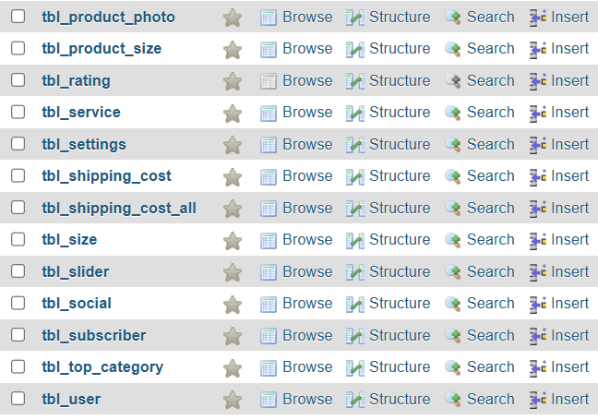
Database

Slide 19
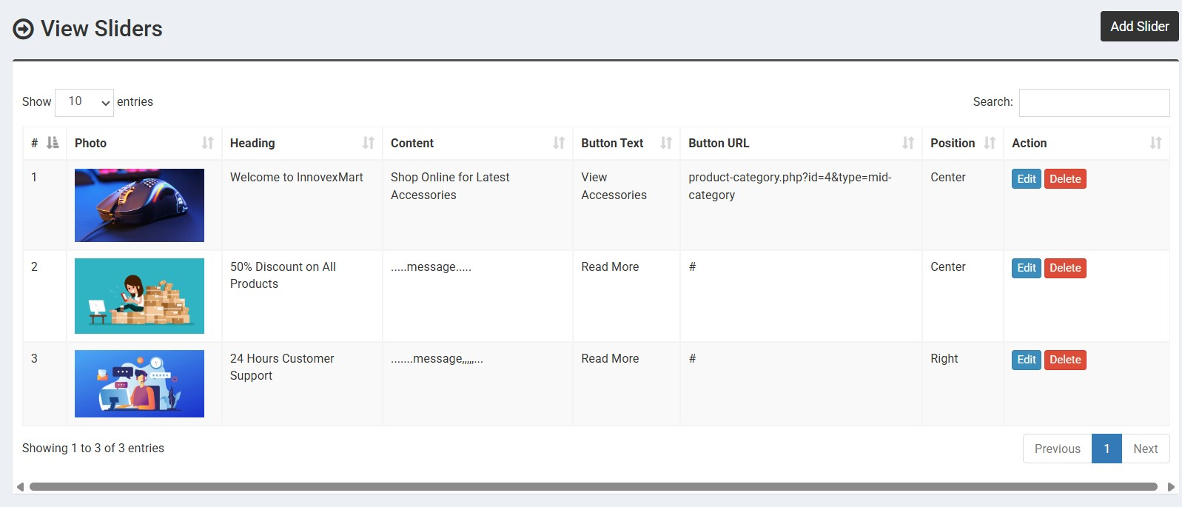

Slide 20
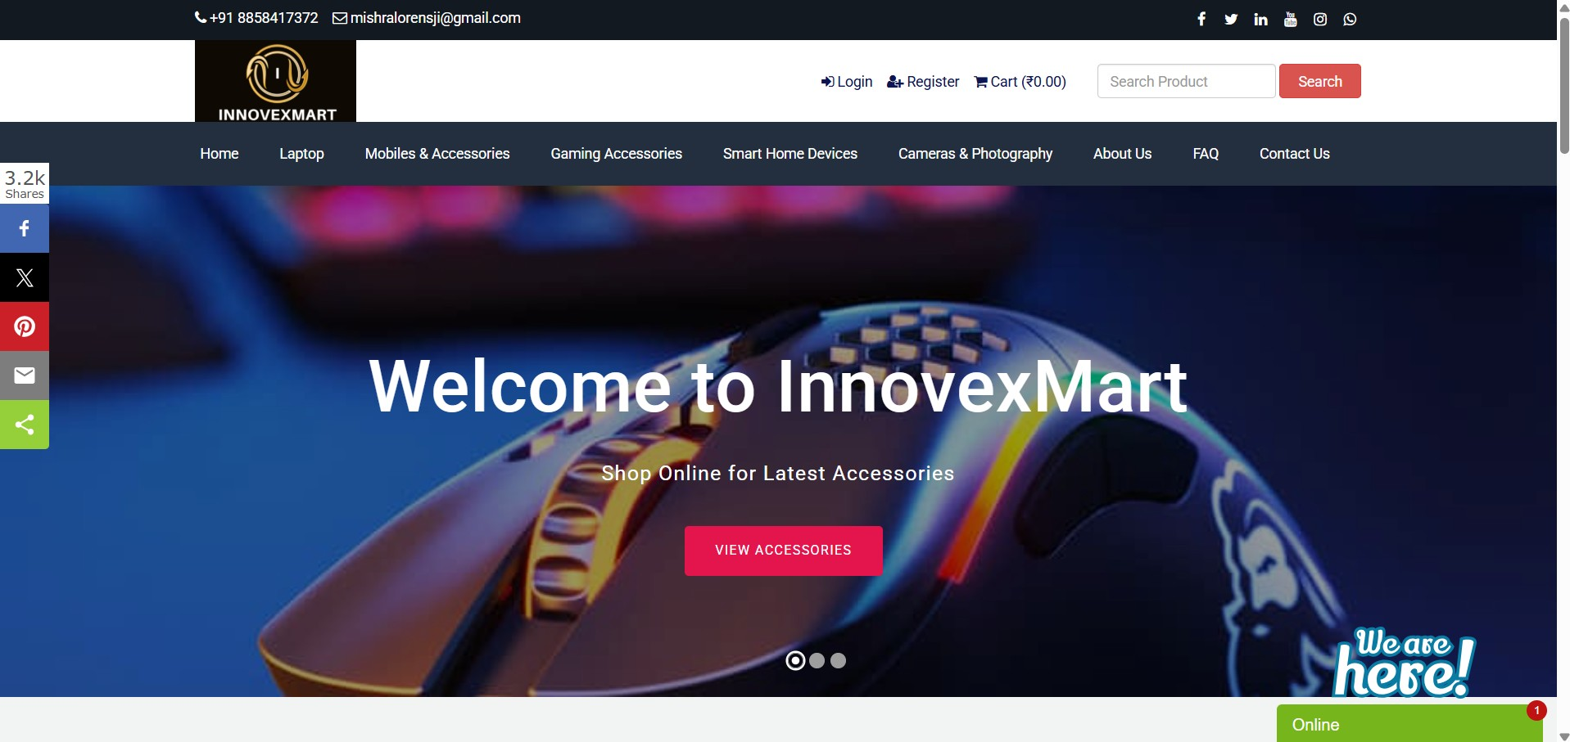

Slide 21
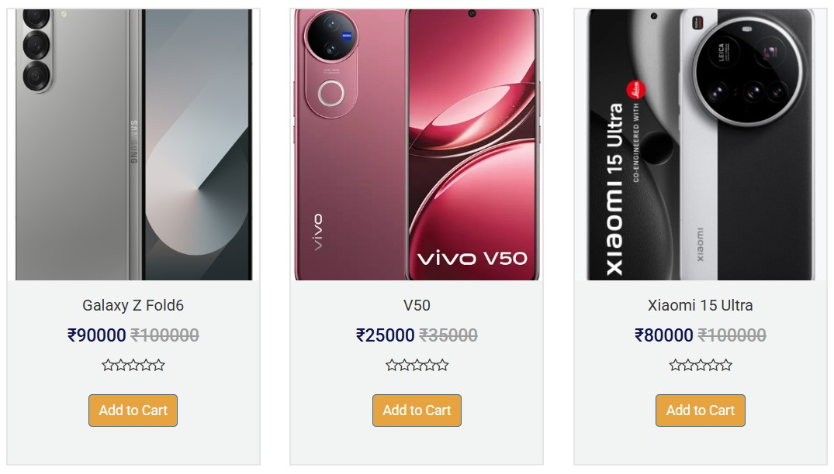
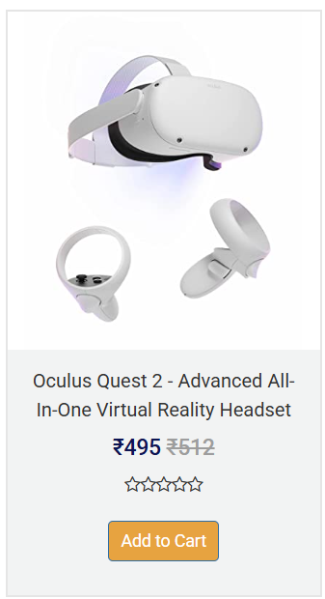
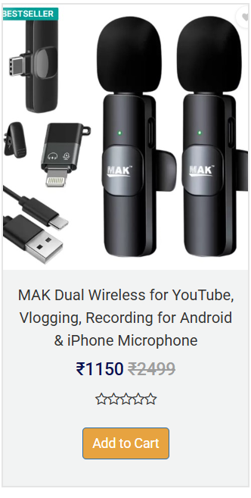

Slide 22
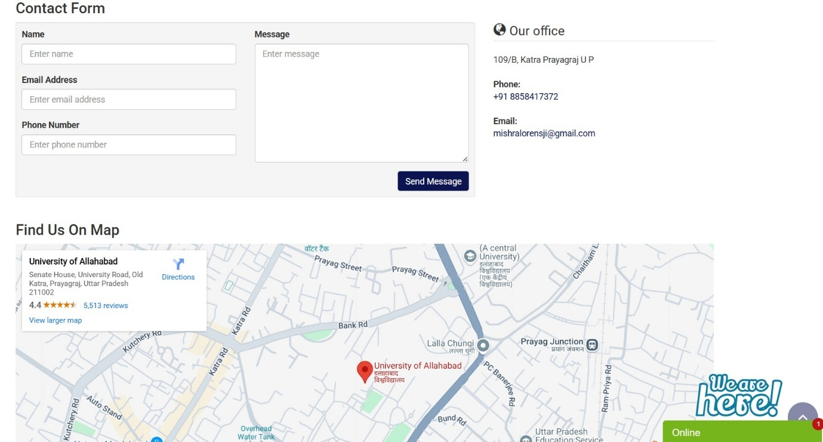

Slide 23
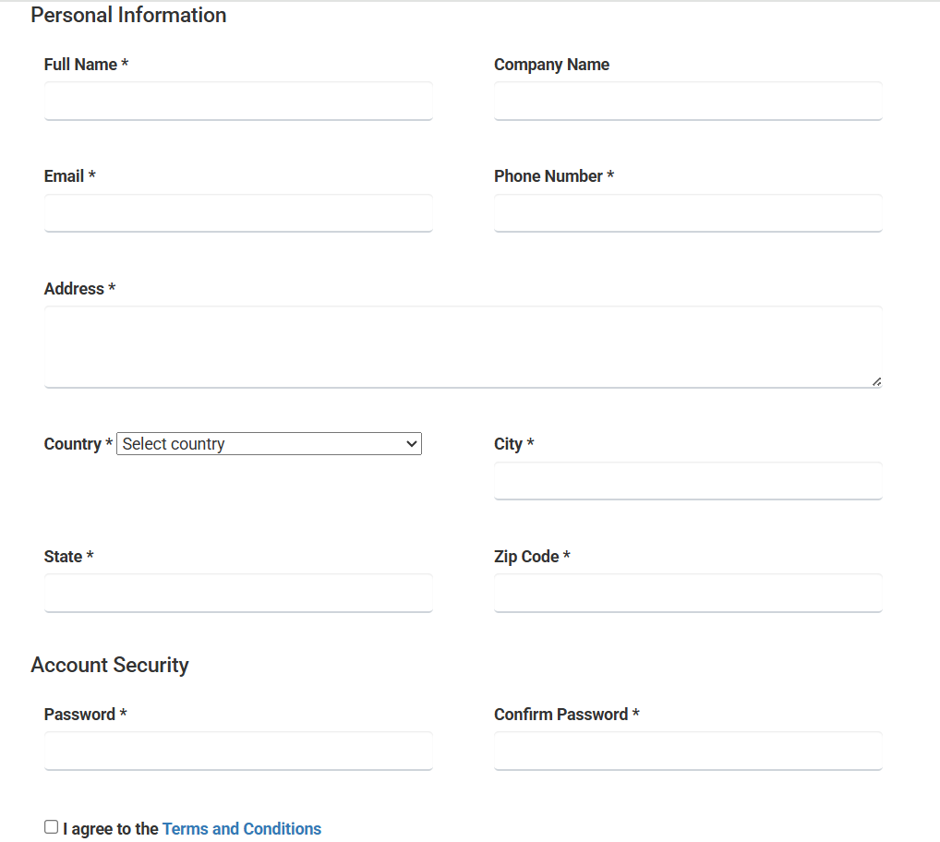
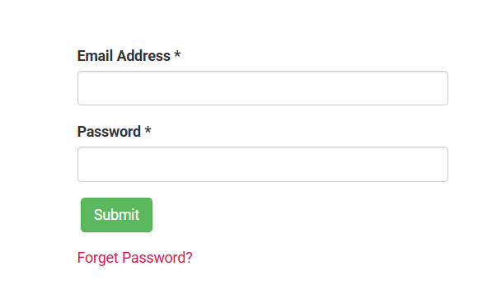
Step: 1
Step: 2

Slide 24
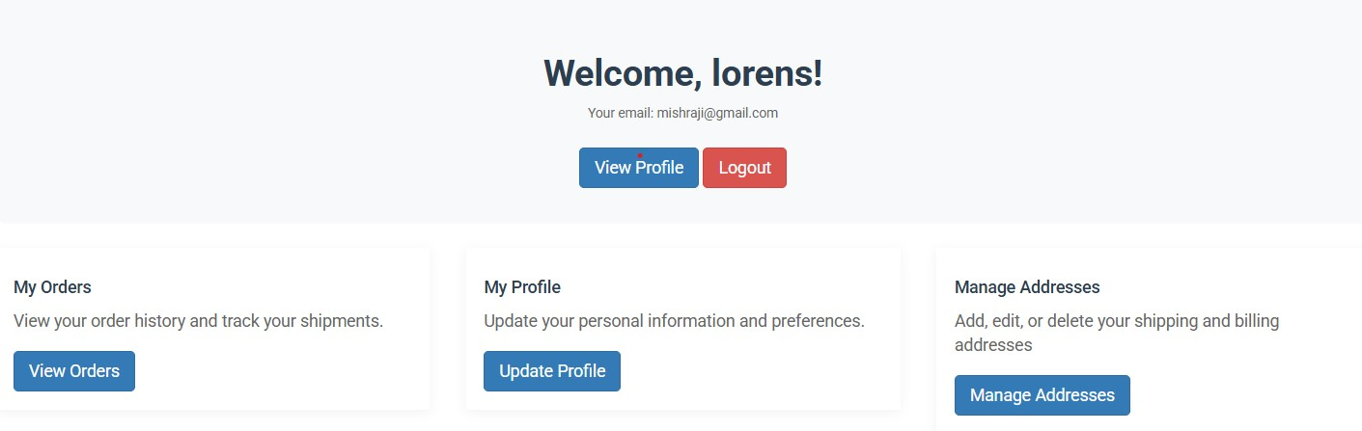




Slide 25
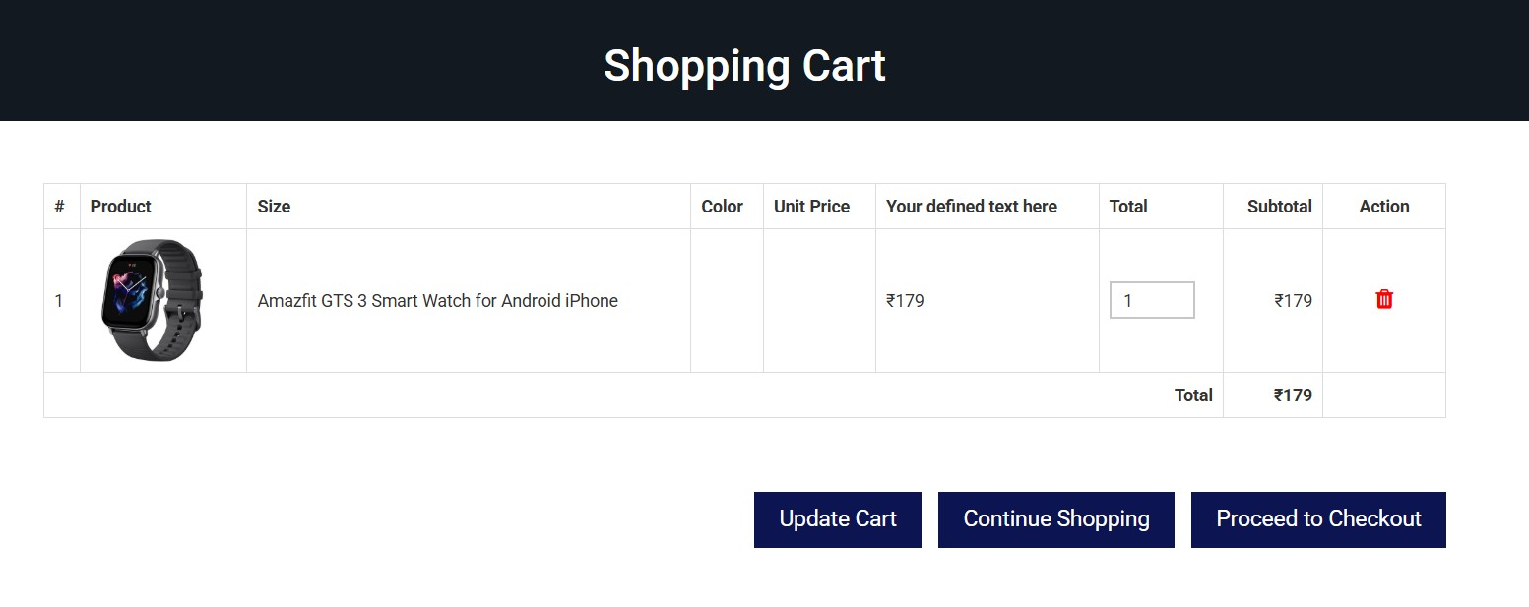



Slide 26
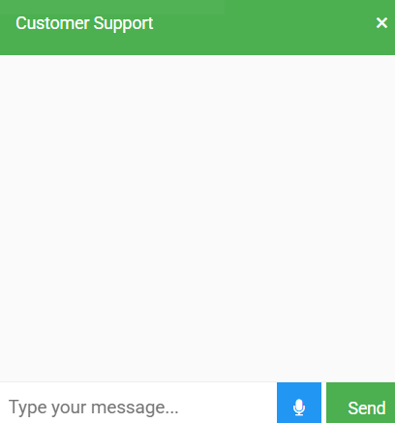
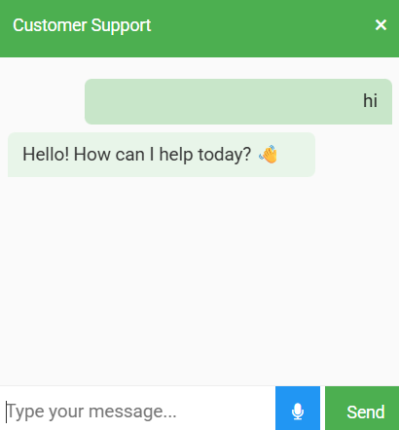
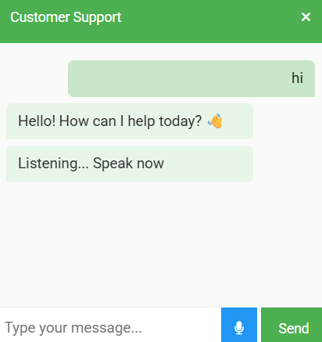

Ask questions
Ask questions type
Ask questions speak

Slide 27
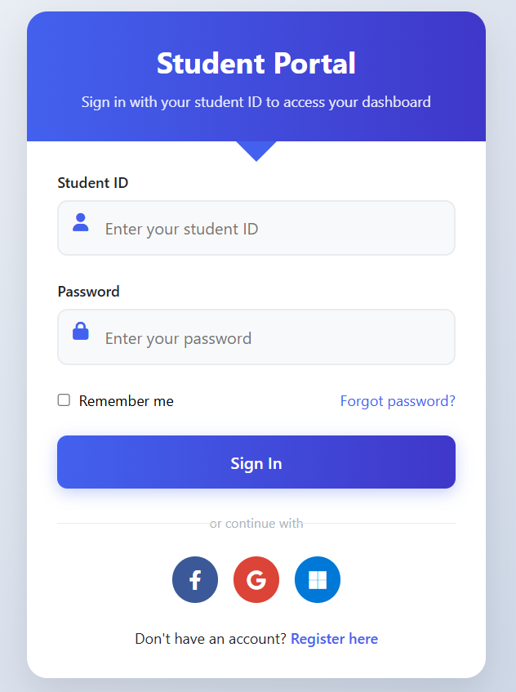

Slide 28
Benefits and Conclusion
Benefits
Global market access and diversified revenue streams.
Competitive advantage via smart delivery systems and AI tools.
Conclusion
Revolutionizing retail with technology and sustainability.
Positioning “Innovex Mart” as a trusted leader in future commerce.

Slide 29


